Slide 1
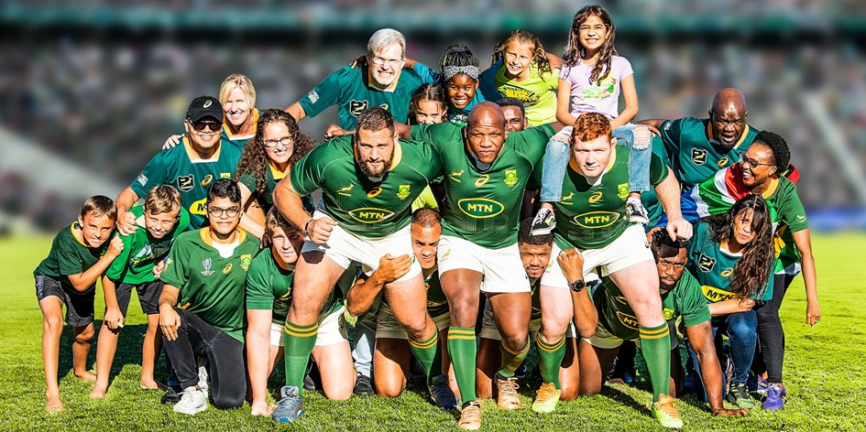


MTN SPRINGBOKS 2022
DEBRIEF
October 2022
“The Home of Springbok Fans”
Built for rugby fans, by rugby fans.

Slide 2
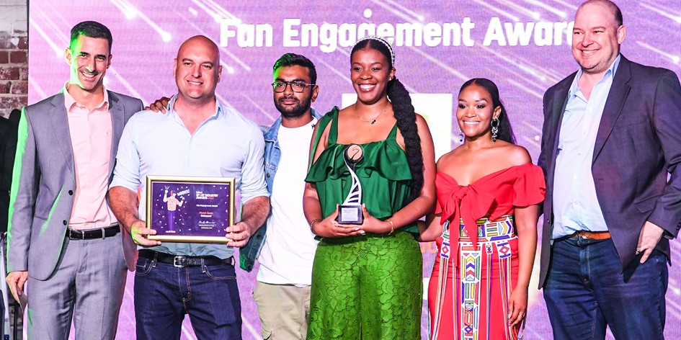
SA Rugby’s new digital fan portal BokSquad won the Best Fan Engagement Award at the 2022 South African Sport Industry Awards
Official SARU Press Release: BokSquad wins big at SA Sport Industry Awards | SA Rugby

Slide 3
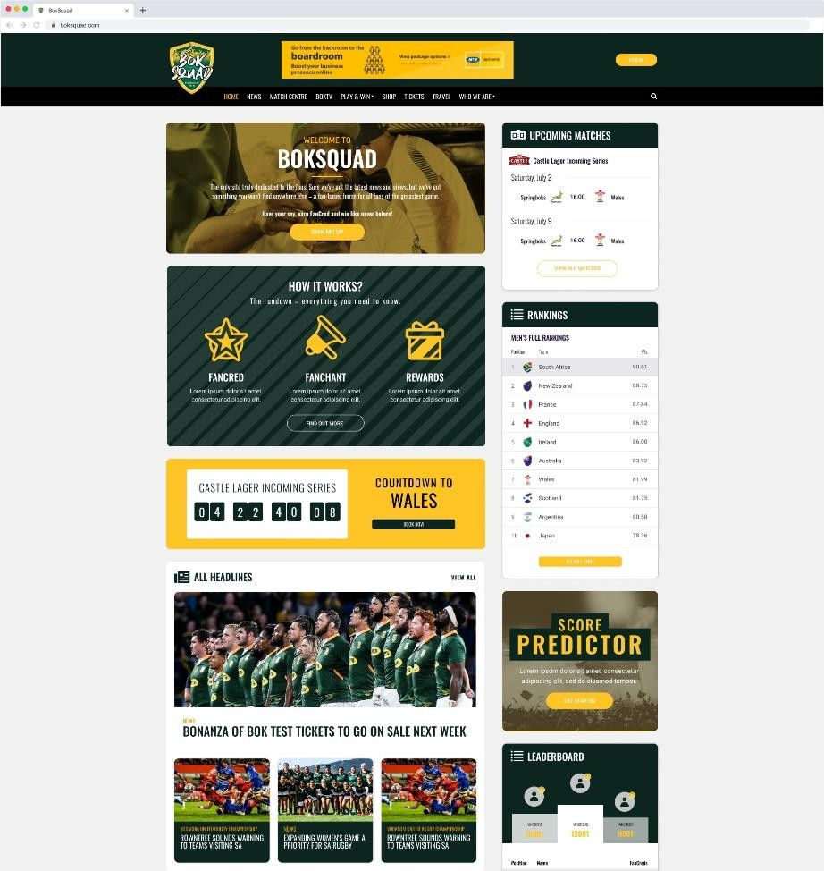
Today, we’ll cover the following:
The Brief and Objectives
The Product
The Audience
Content Evolution
Fan Experiences
Activations and Campaigns
The Numbers
BokSquad – WASPIE Awards Submission 2023

Slide 4
01
The Brief and Objectives

Slide 5
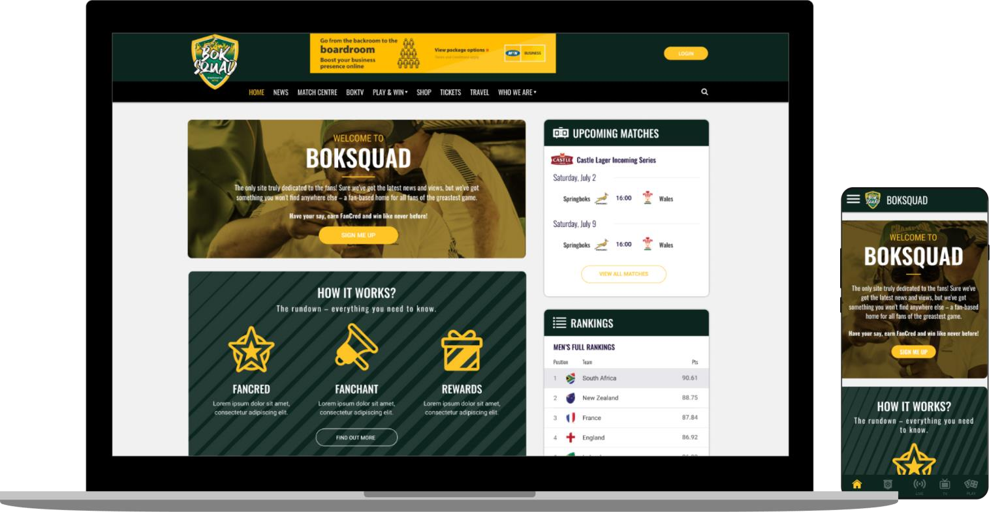
The Brief
MTN South Africa briefed Ole Connect to create an exciting and engaging digital experience for Bok supporters with the goal of creating a home for Springbok fans. This included:
  Creating a distinctive digital experience within digital sport publishing.
  Leveraging MTN’s Springbok sponsorship property through creating exclusive content.
  Building a platform to house the exclusive content and create opportunities for monetization.
BokSquad – WASPIE Awards Submission 2023

Slide 6
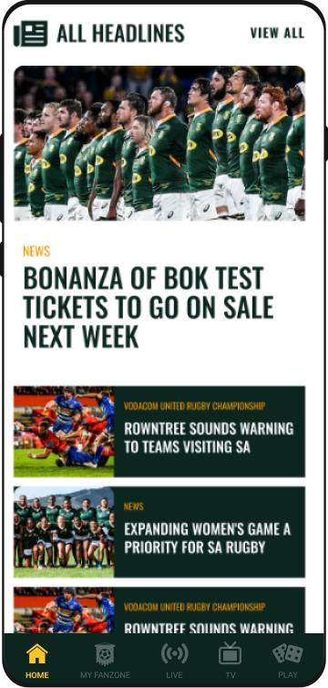
The Objectives
Provide and create highly desirable content
Utilise a unique editorial voice
Mobile first approach to fan engagement
Deeply layered content that is simple to access, use and understand
Create multiple monetization points using various transaction methods
Create a platform, audience and marketing opportunities that are highly desirable for advertisers and brands.
BokSquad – WASPIE Awards Submission 2023

Slide 7
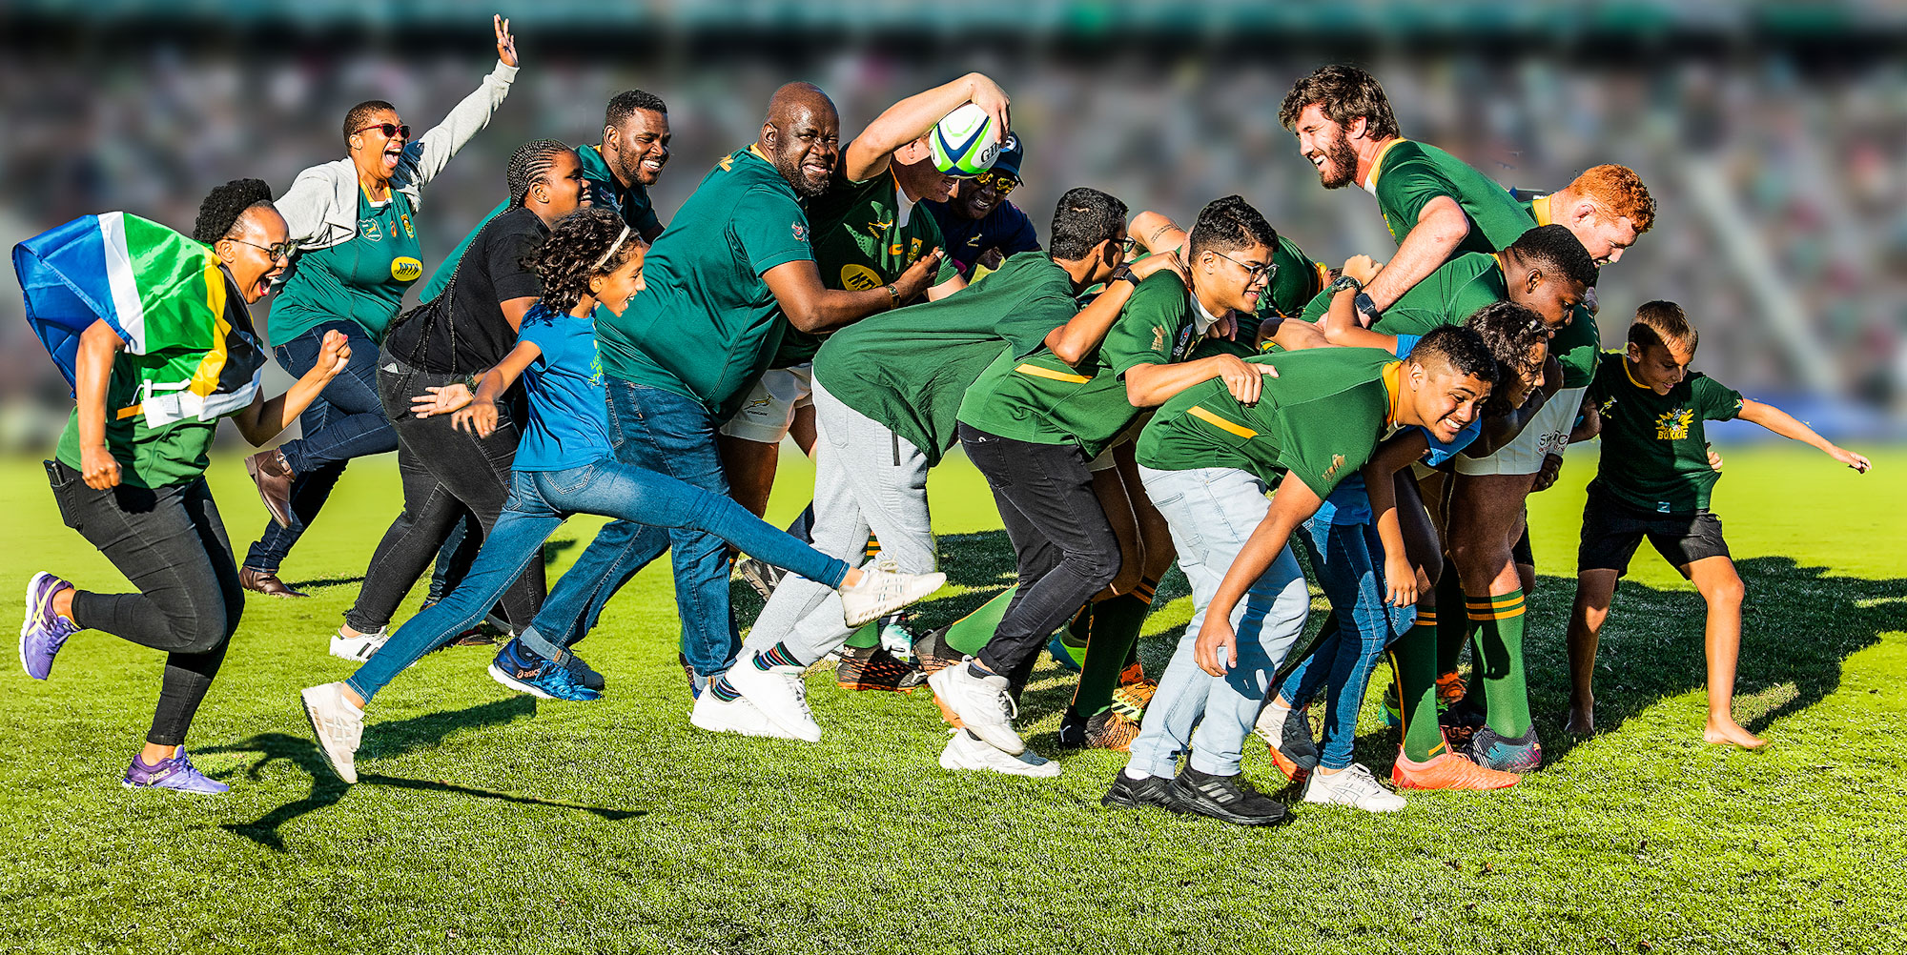
Leveraging Sponsorship
As a proudly South African brand, MTN is passionate about our country and the Springboks as our sporting heroes. MTN joined the Bok's journey in 2017 and saw how the Boks brought a nation together in 2019 when they won the Rugby World Cup for a third time.
Our heroes are here and everyday they continue to unite our country to build a better South Africa. Therefore, MTN are proud to continue our journey with the Boks until 2025.
Official SARU Press Release: Bomb Squad morphs into digital BokSquad for fans | SA Rugby
BokSquad – WASPIE Awards Submission 2023

Slide 8
02
The Product

Slide 9
The largest and most loved digital destination for rugby fans will
=
the most engaged, dedicated and monetized audience possible.
Introducing

Slide 10
What is Bok Squad?
“The Home of Springbok Fans” Built for rugby fans, by rugby fans.
For those who live and breathe rugby, who love the game.
A dedicated home with all they
could want & need.
An every day, always-on, place to congregate and engage.
BokSquad – WASPIE Awards Submission 2023

Slide 11





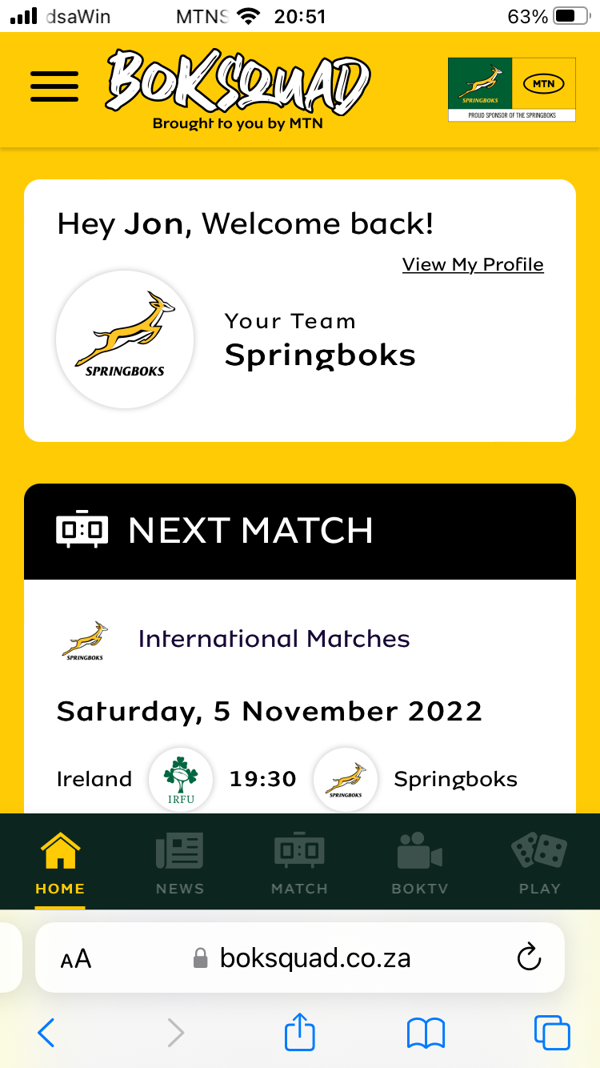
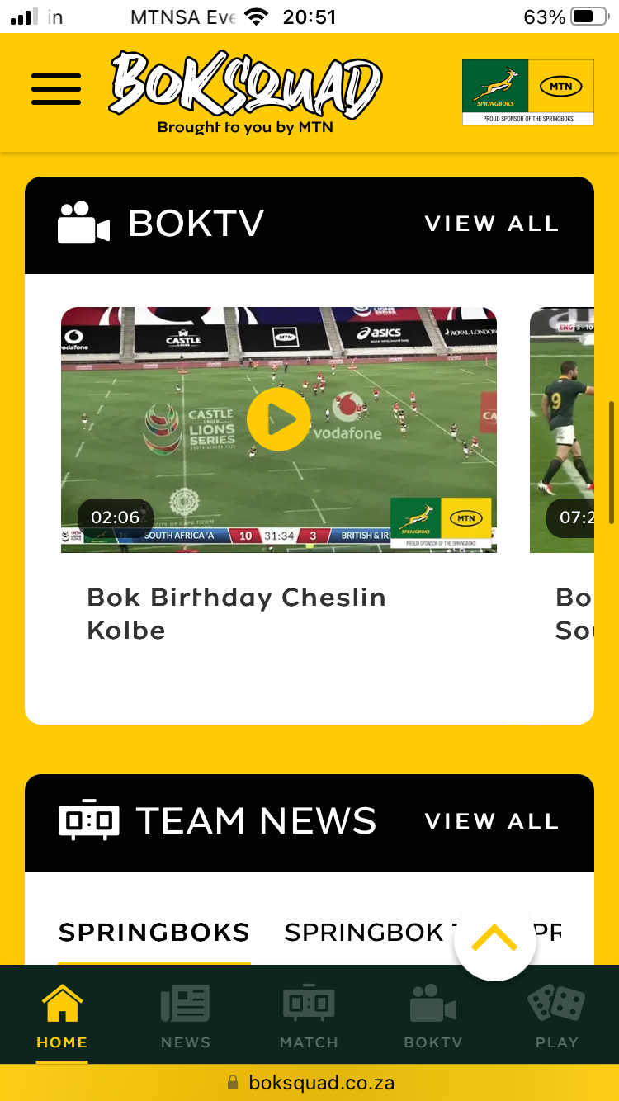
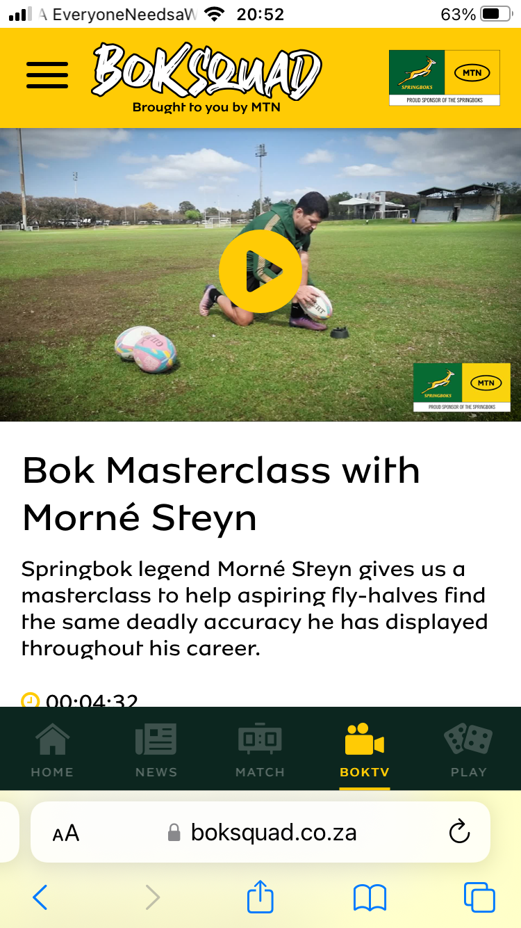
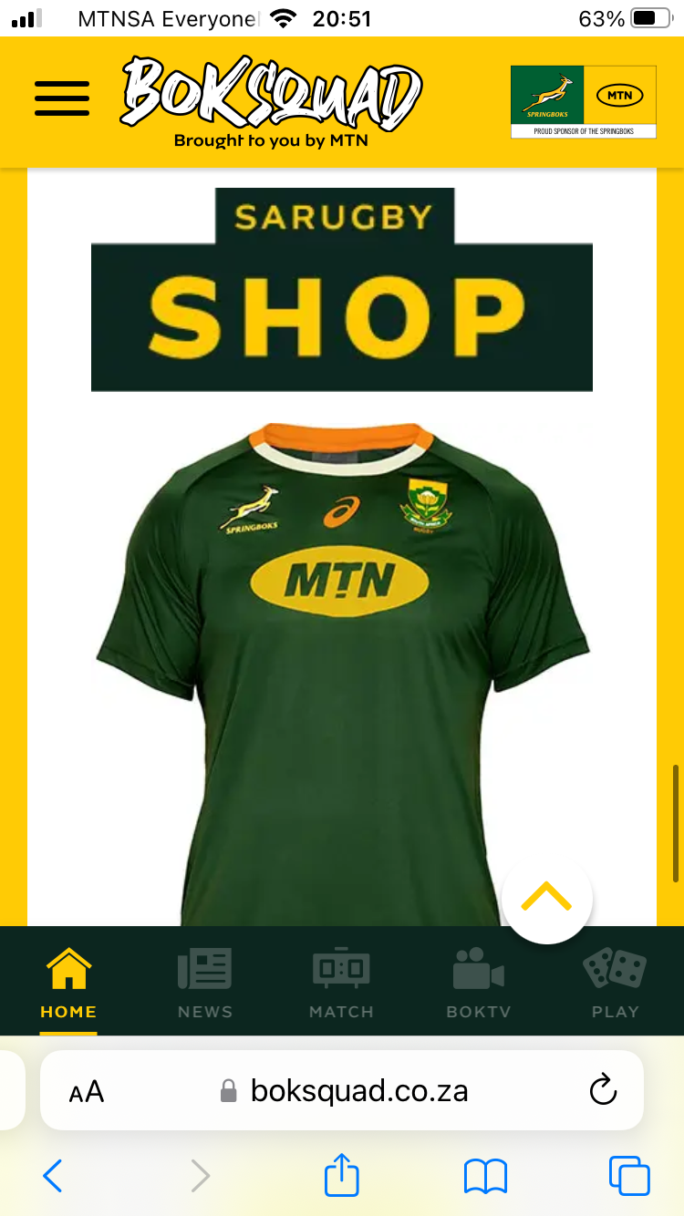
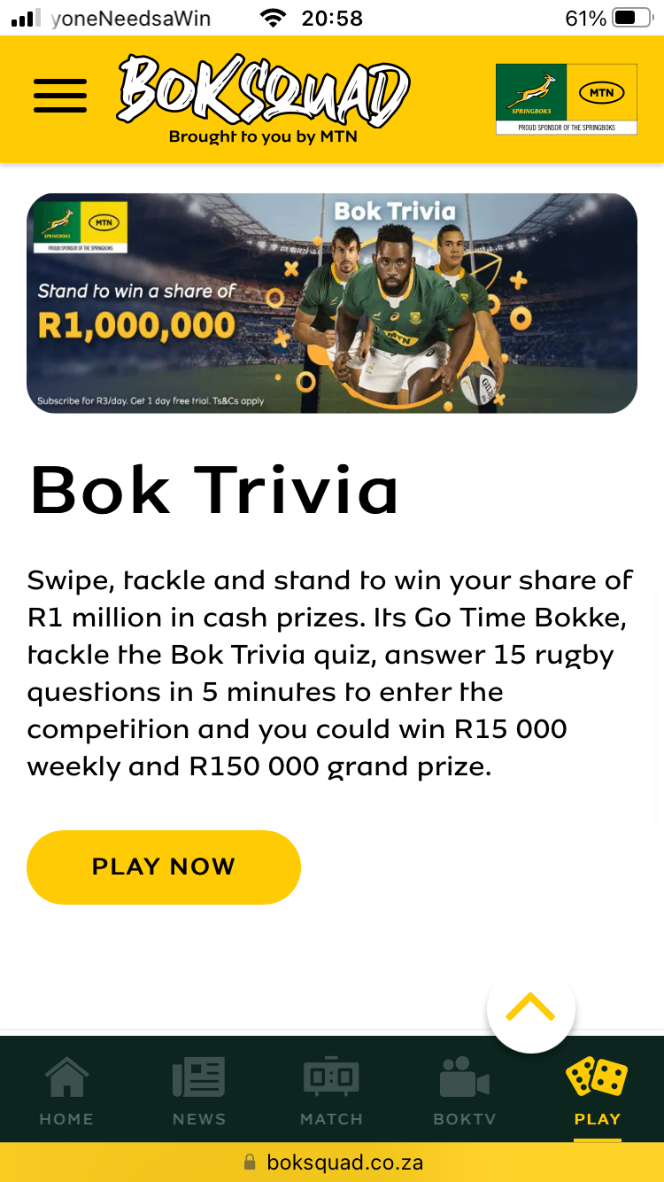
Product Features
MOBILE
FIRST
RICH MEDIA CONTENT
EXCLUSIVE
ACCESS
ECOMMERCE SHOPPING
PLAY
AND WIN
BokSquad – WASPIE Awards Submission 2023

Slide 12
03
The Audience

Slide 13
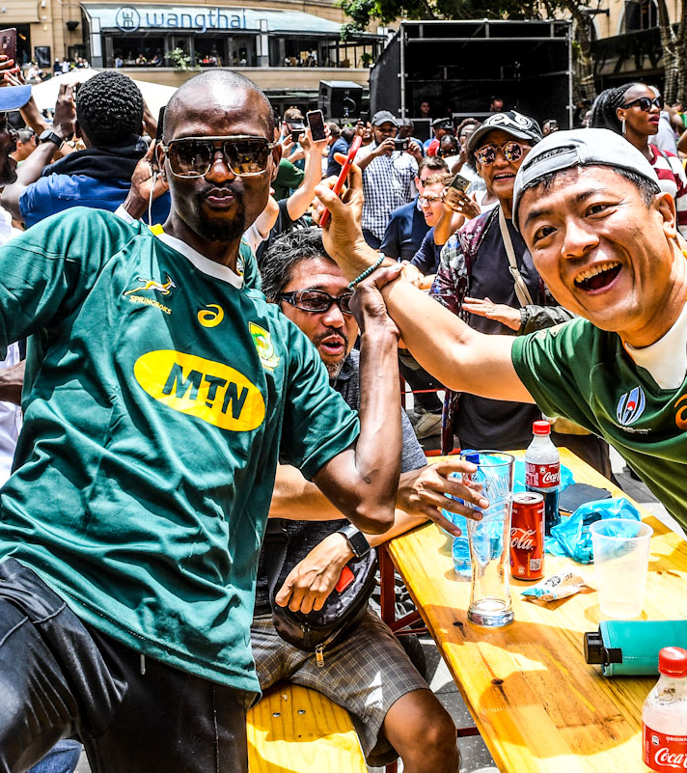
What does being a Bok fan mean?
It’s more than a simple interest in something...
It’s a love for something.
A devotion, dedication, an unwavering support.
You’re more than just interested, you’re fanatical.
You’re a fanatic.
You are a fan.

Slide 14
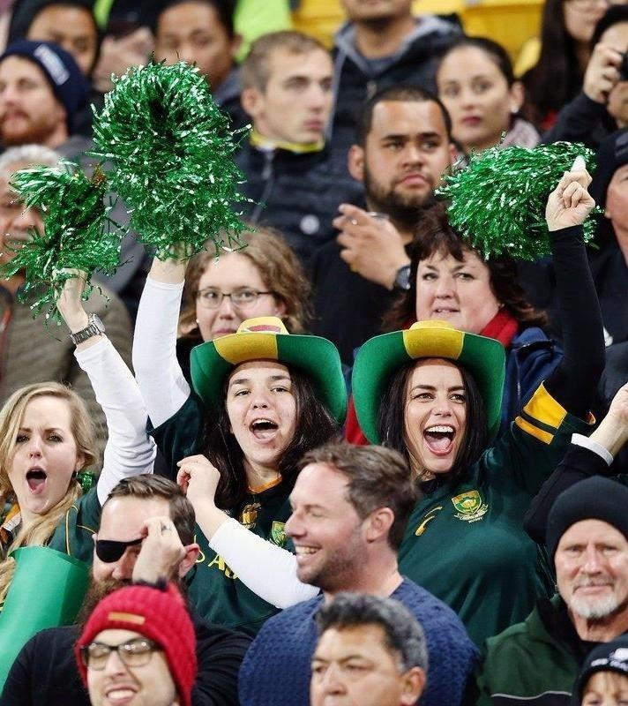
Who they are and what they want:
Fans want to know everything: Past, present, future – they want to see behind the curtain.
Fans are passionate live supporters.
Fans emblazon their lives with fan kit – and will spend to get it.
A fan wants to voice their opinion. To show how much they know, how dedicated they are, and how they are a true fan.

Slide 15
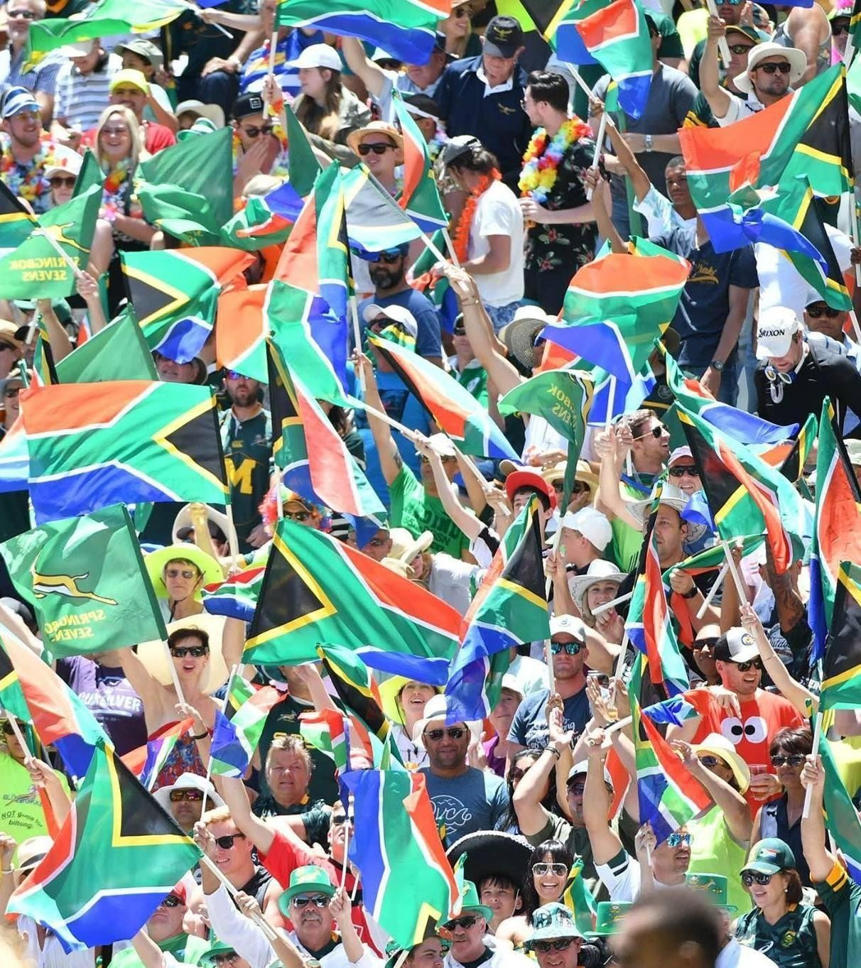
What do they need?
Being a rugby fan transcends the enjoyment of watching a game... It forms part of everyday life.
Part of who they are.
But how do they live the true fan experience on a day-to-day basis? They need a platform dedicated to strengthening the fan experience. That enhances every interaction of a passionate fan.
Somewhere to support every day.

Slide 16
04
Content Evolution

Slide 17
Types of Content
General
Match Content
Stand Alone
BokSquad – WASPIE Awards Submission 2023

Slide 18
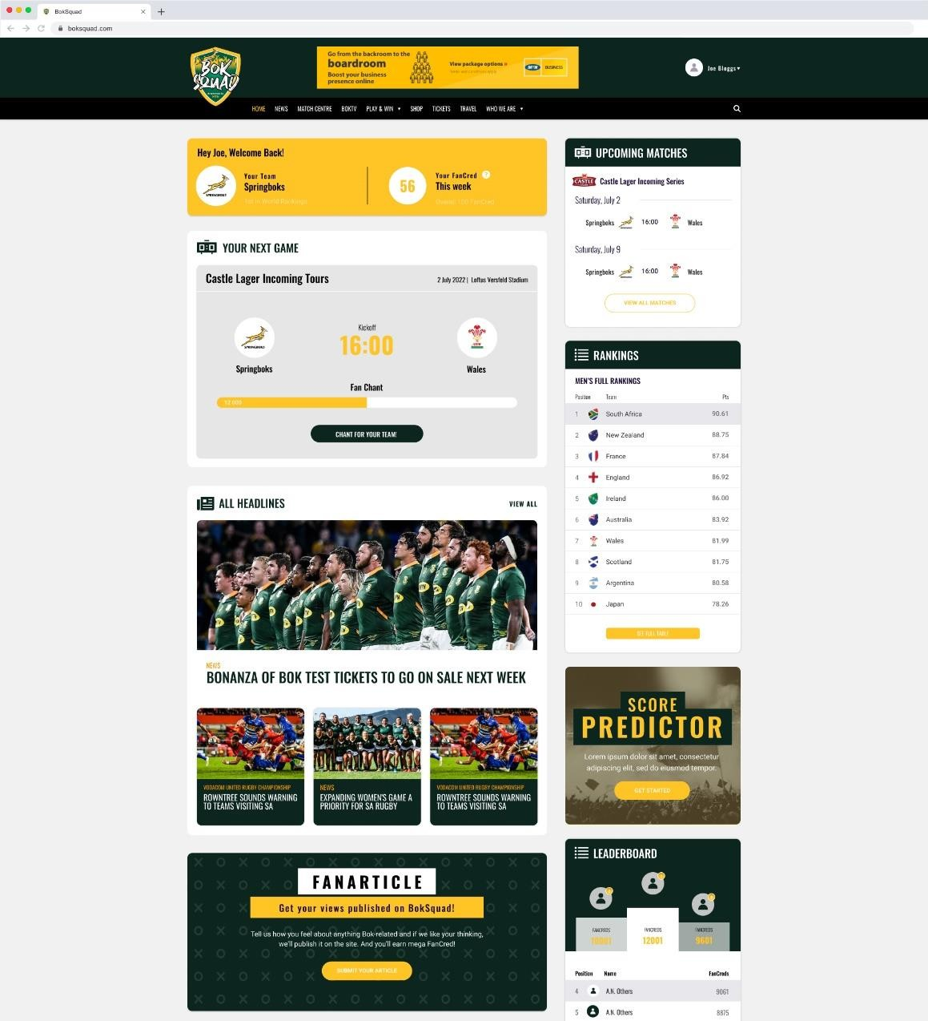
Editorial Content
This is our news and review editorial content
Similar to what you may find on competitor publications, but with our unique take.
Examples include News, Previews, Reports,
Fixtures/Results, Tables, Live scores etc
Included would be the following:
  Unique Content
  Unique Voice
  Easy and simple UX/UI
  For the fans by the fans theme / lens
BokSquad – WASPIE Awards Submission 2023

Slide 19
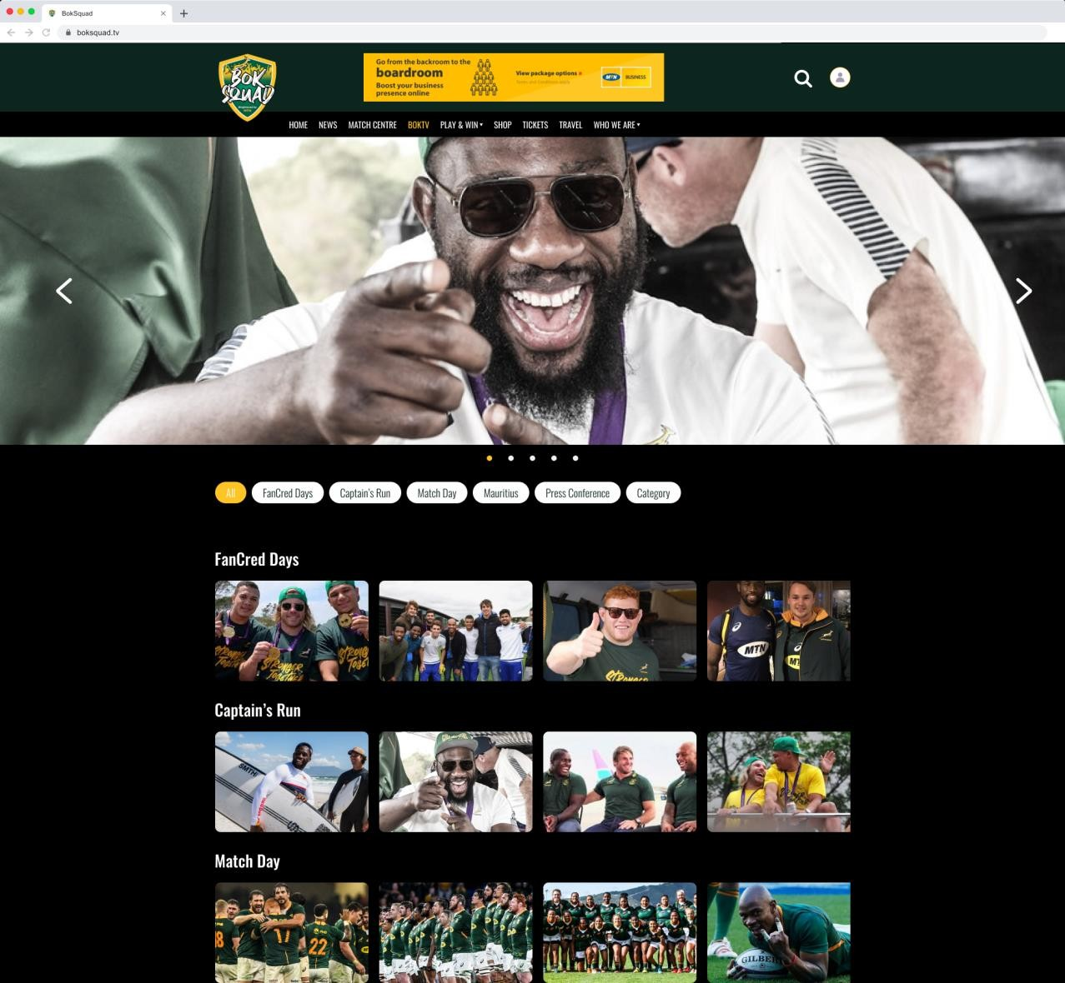
Editorial Content
The Must-Haves
Local rugby news
International rugby news
Opinion articles
Listicles
Video
Fixtures
Results Tables
BokSquad – WASPIE Awards Submission 2023

Slide 20
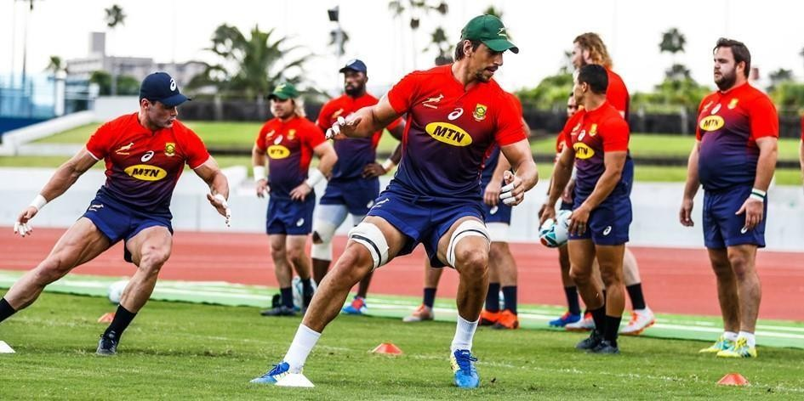
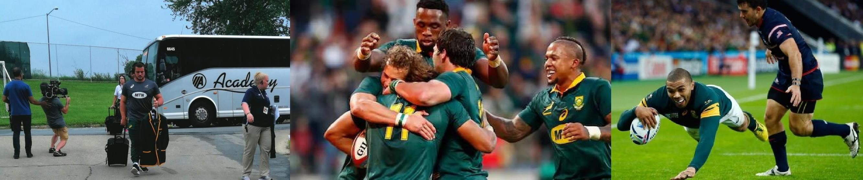
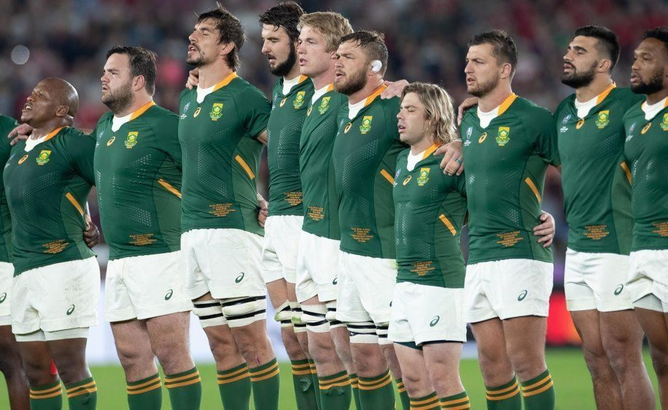
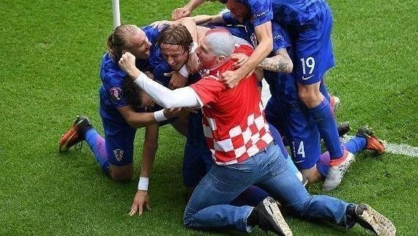
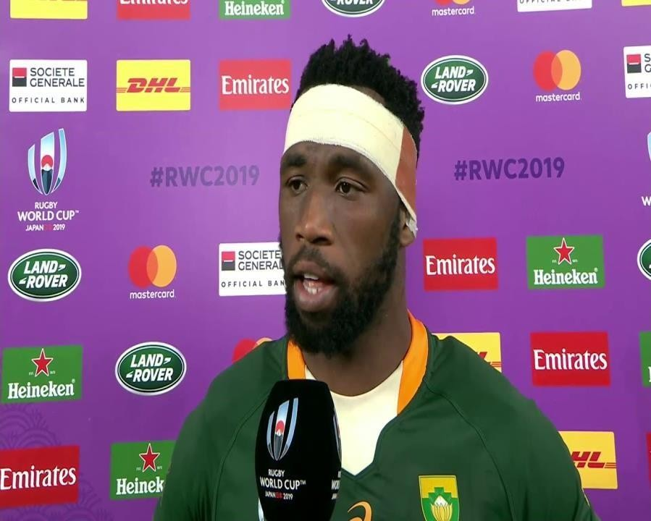
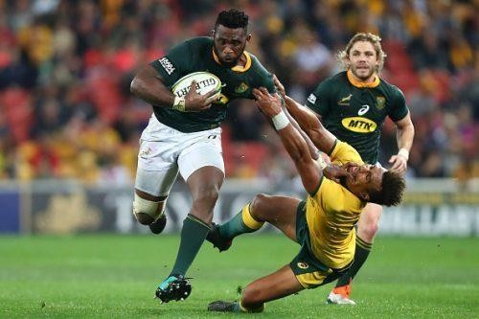
Match Content
Modeled on the fan experience leading up to, during, and post matches for their South African rugby team of choice.
BokSquad – WASPIE Awards Submission 2023

Slide 21
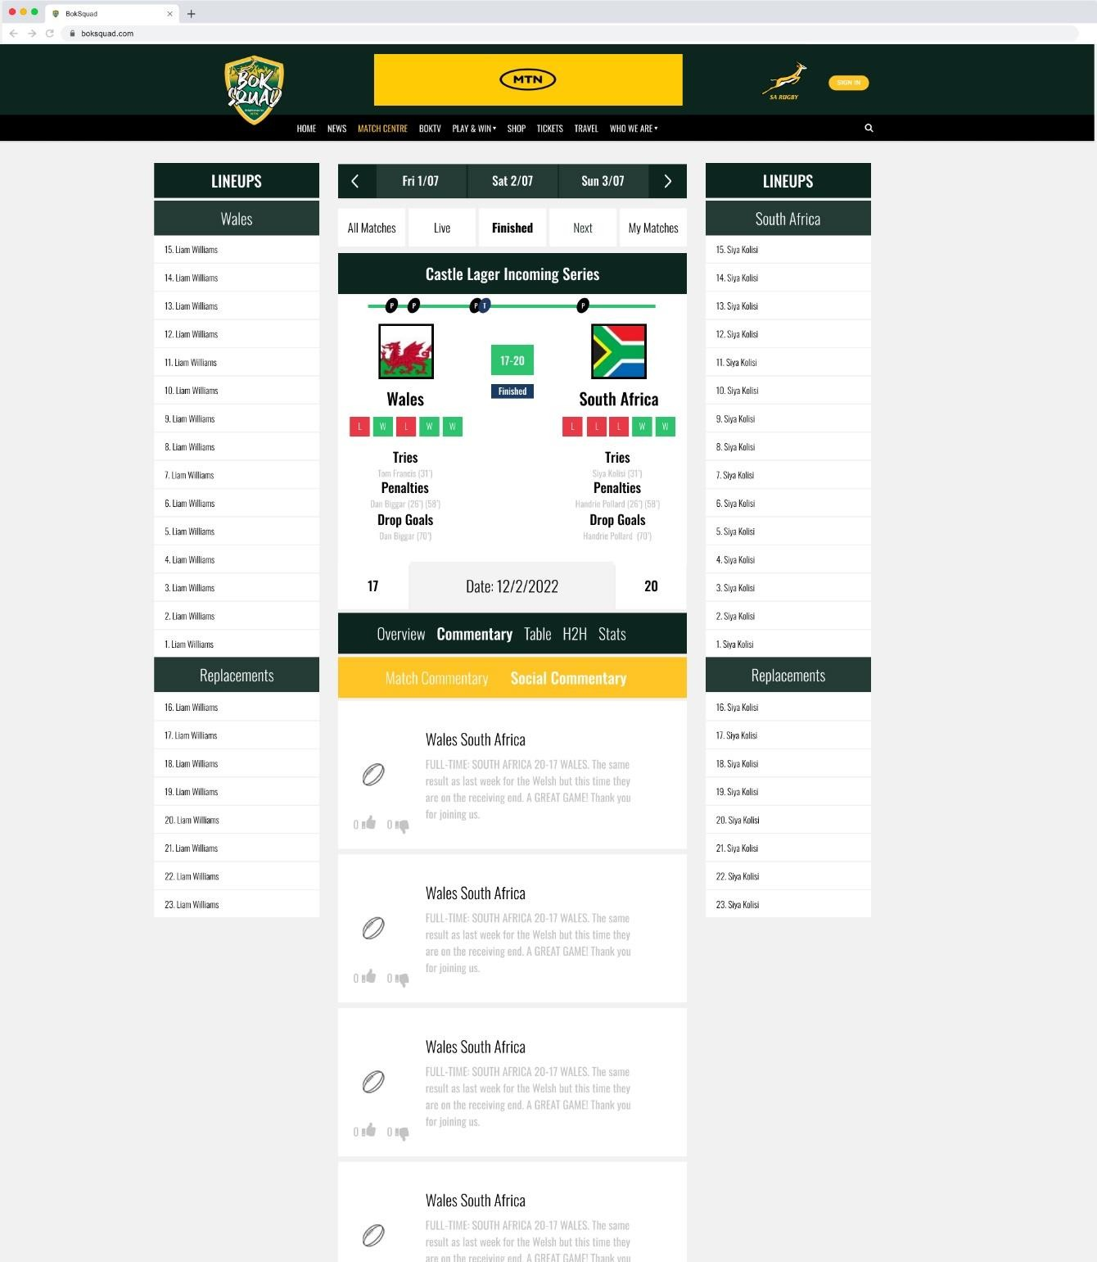
Match Content
The way we package and guide the user through this journey will aid in rich and rewarding interactive experience for fans and create several transactional opportunities.
BokSquad – WASPIE Awards Submission 2023

Slide 22

Match Content Types
Pre-
Injury News; Press Conference Line-Ups; Match Analysis; Score Predictor
History of Fixture
Player Performance Player
Profiles Pundit Opinions
Who’s Watching & Where
Pre-Match Banter; Who Said What Influencing Factors; Final Injury Report; Final Line-Ups; Tactics Score Predictor; Travel Plans Merchandise; Fan Notice Board
During-
Live Scores
Live text commentary & audio Live Images
Match stats
In-line Social media
Historical data More on request…
Post-
Post Match Analysis
Match Report Player
Performance Ratings
Man of the Match
Stand-Out
Performance Press
Conference.
Fan Winner.
Announcements
Merchandise Player
Interviews
Who Said What
Fan Reactions
Fan Notice Board.
BokSquad – WASPIE Awards Submission 2023

Slide 23
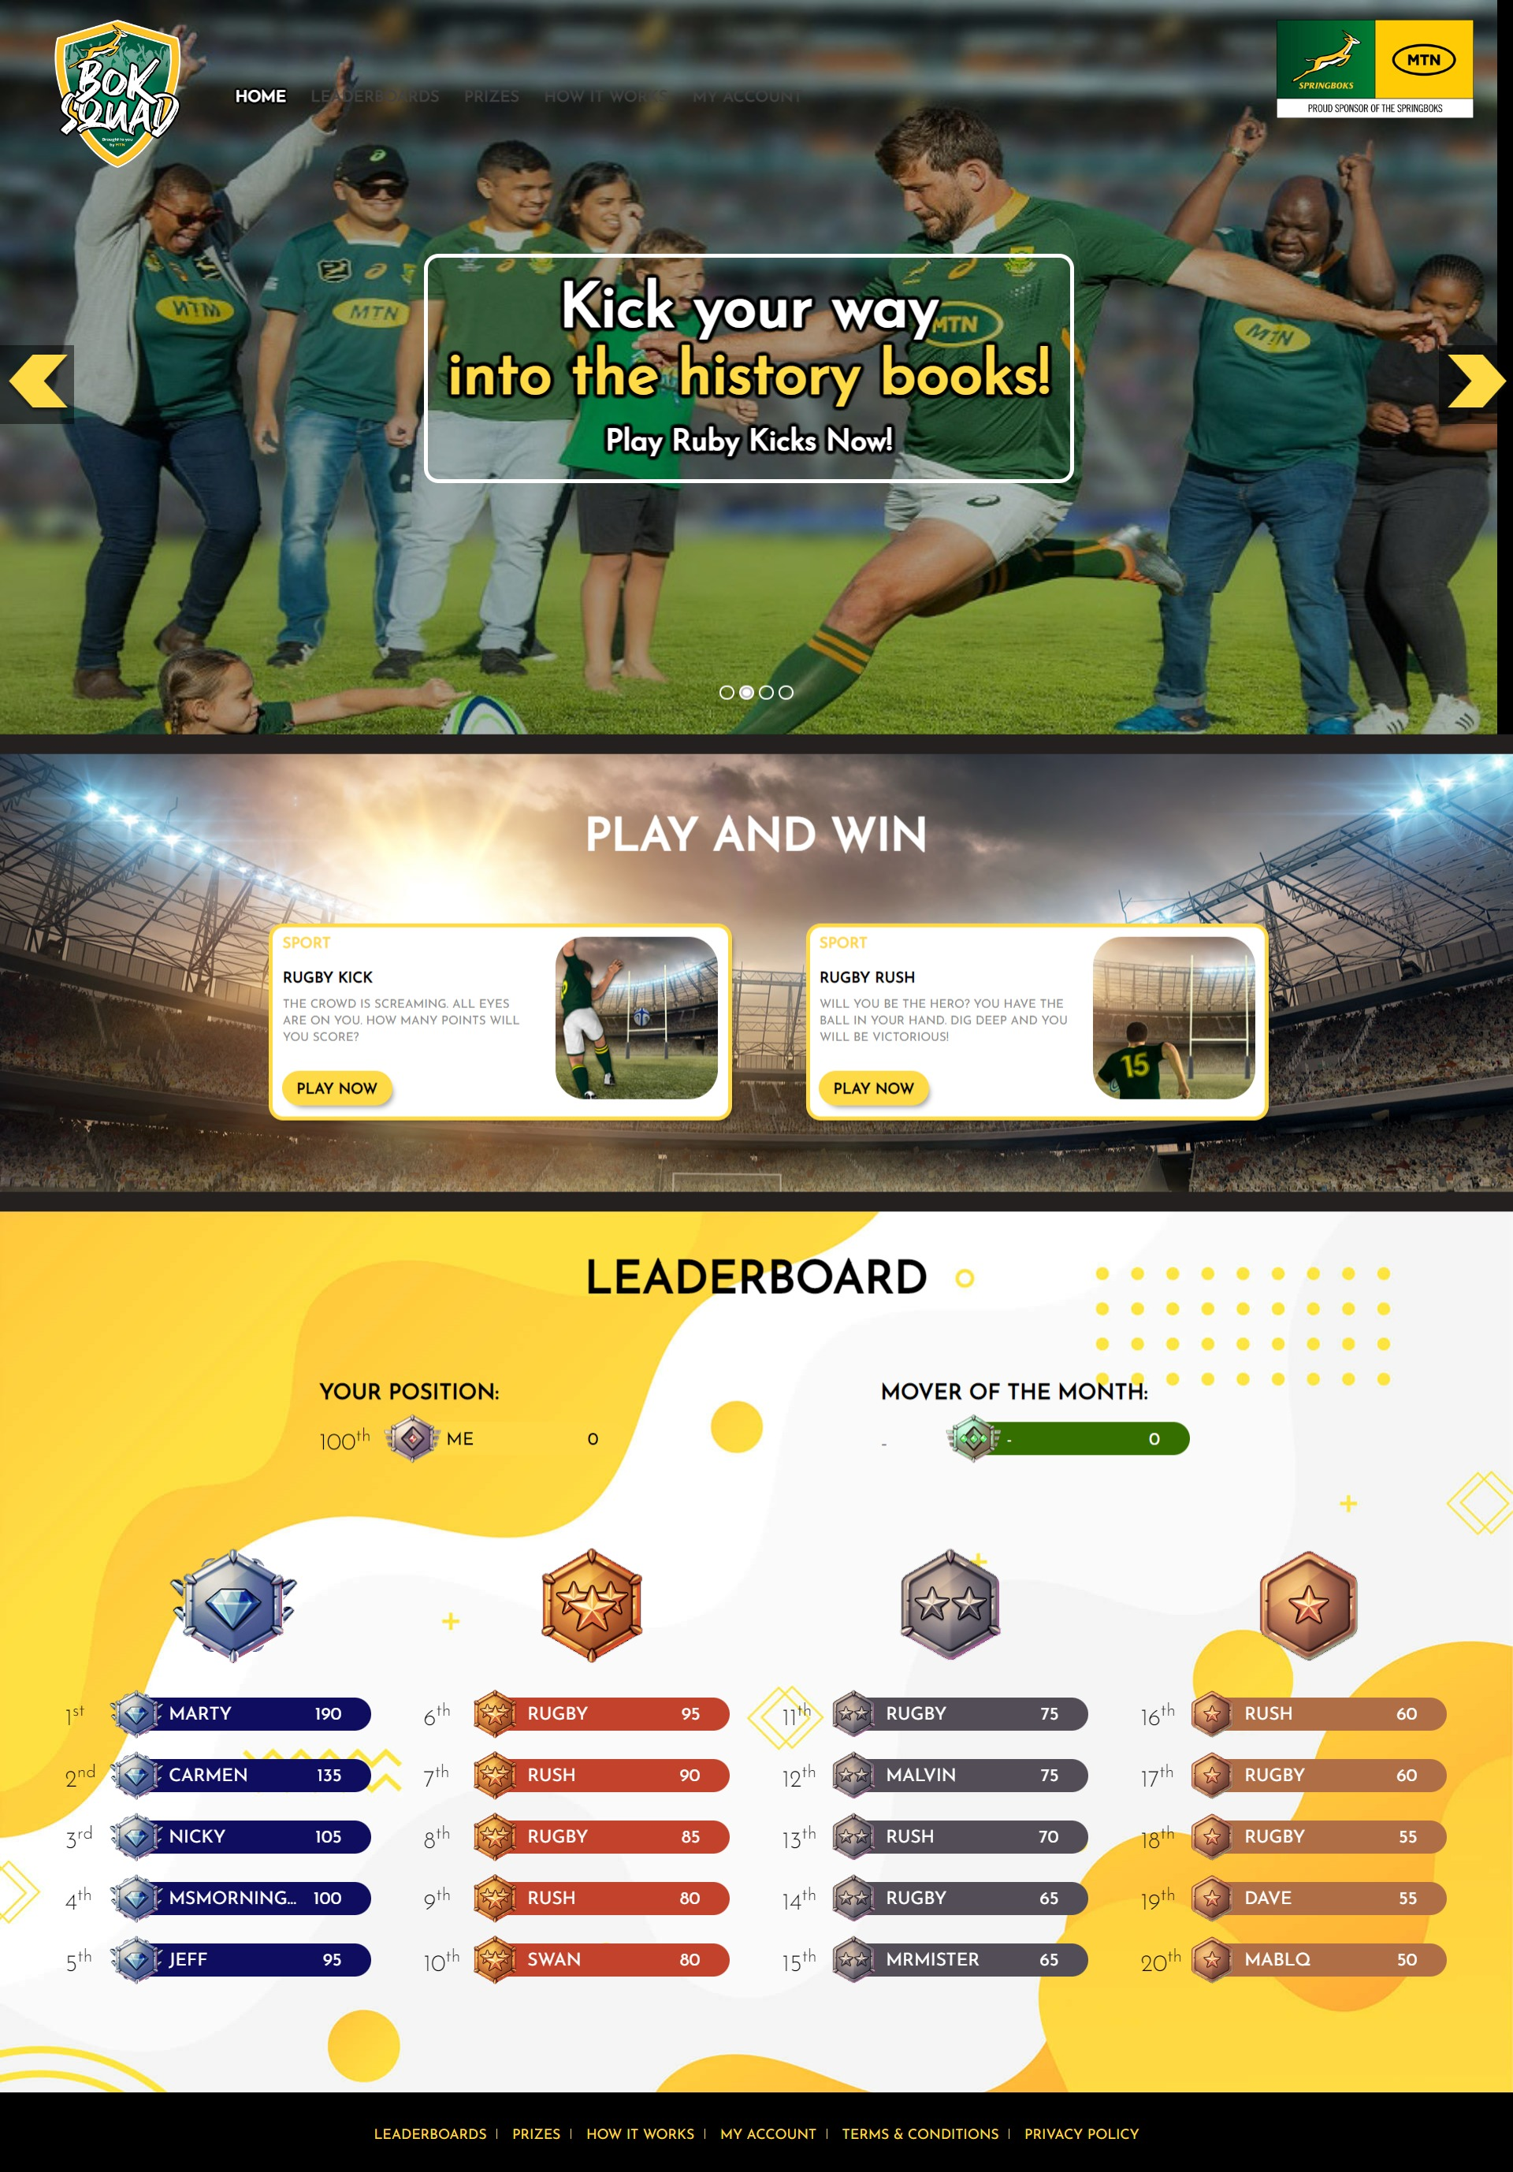
Stand Alone Content
Exclusive BokSquad video content
Fan Experiences
Gaming and Competitions
In-Game Commentary
Exclusive offers.
BokSquad – WASPIE Awards Submission 2023

Slide 24
05
Fan Experience

Slide 25
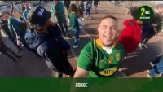
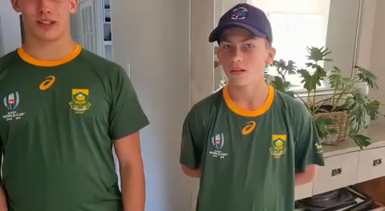
Fan Experience
As MTN continues its journey from being a telco to becoming a techno, we deliver the best digital subscription services to our customers by leveraging our sponsorships, for example: the Boks.
Click to Play
Click to Play

Slide 26
06
Activations and Campaigns

Slide 27


Stadium Activations
Click to Play
Click to Play

Slide 28

Subscriber Acquisition Campaigns (OnePin)
Catch the Boks in action
Join BokSquad & you could WIN tickets to SA vs the All Blacks!
Click Accept & get the 1st day FREE only R3/day
Click Accept to confirm your subscription @R3/day
HURRY! You don't want to miss the game of the year! SA vs the All Blacks!
Y'ello, Thank you for subscribing to BokSquad at R3.00/day or lesser amount. To cancel dial *155#. Call 135 for help. Tz&Cs www.mtn.co.za
Call to action Message
Subscription Activation
SMS Confirmation Message

Slide 29
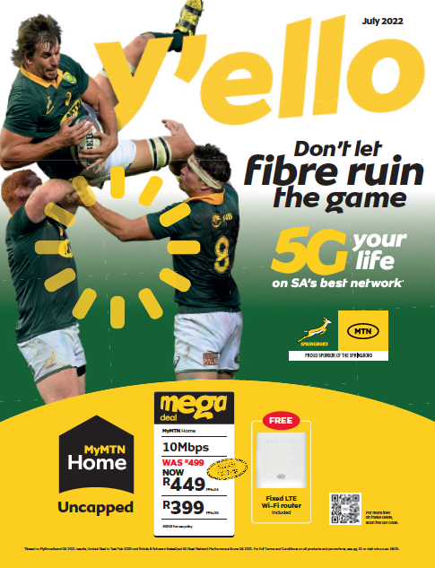


Y’ello Trader Magazine Covers

Slide 30
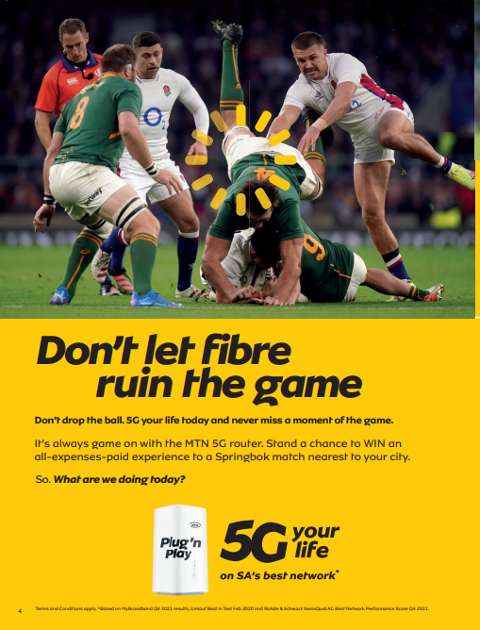
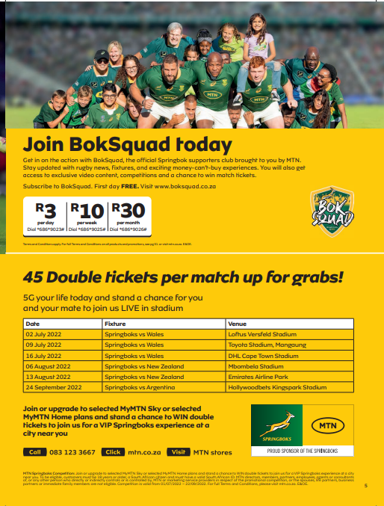
Y’ello Trader Adverts

Slide 31
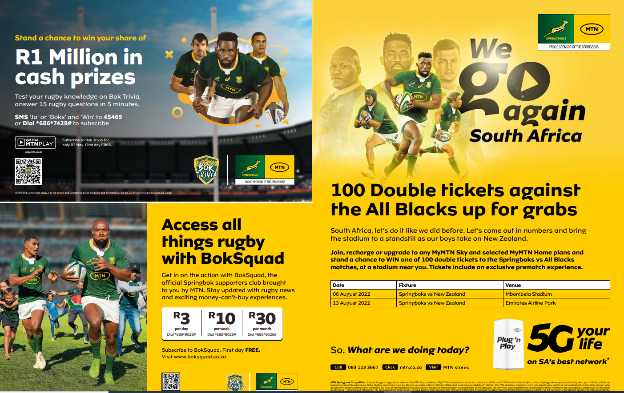
Y’ello Trader Adverts

Slide 32


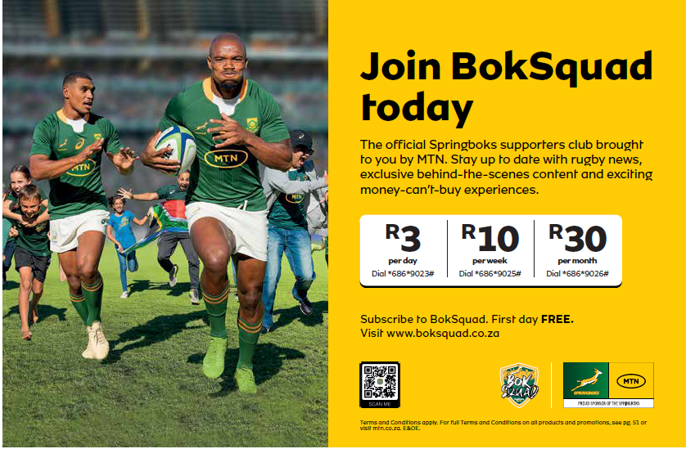
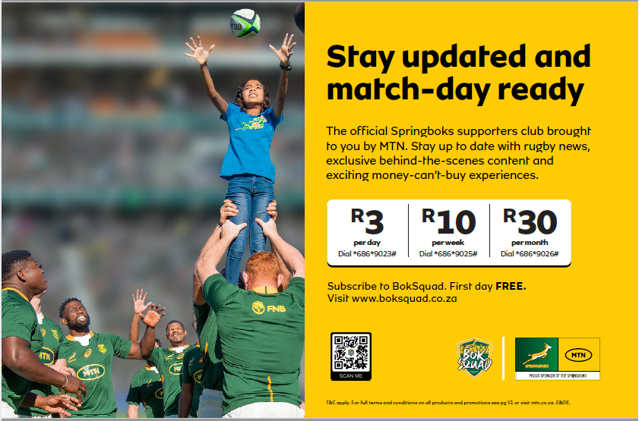

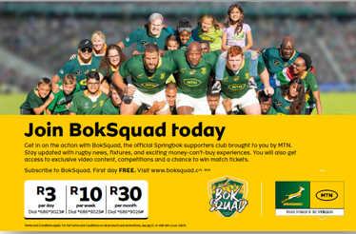

Digital Acquisition Campaigns

Slide 33
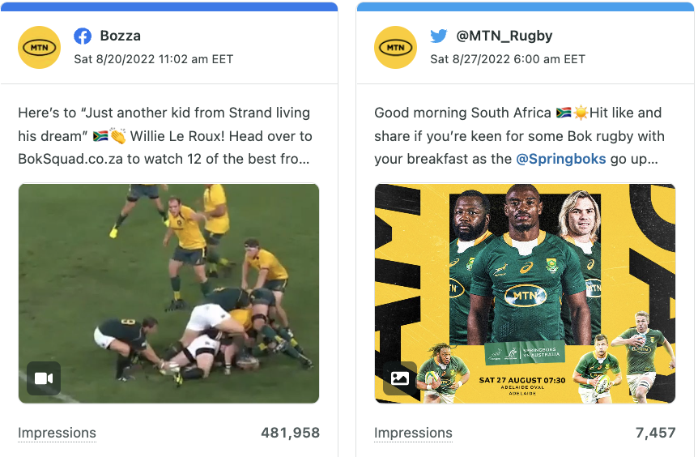
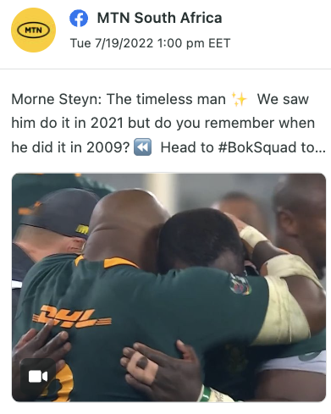
Social Media
Click to VIEW
Click to VIEW
Click to VIEW

Slide 34
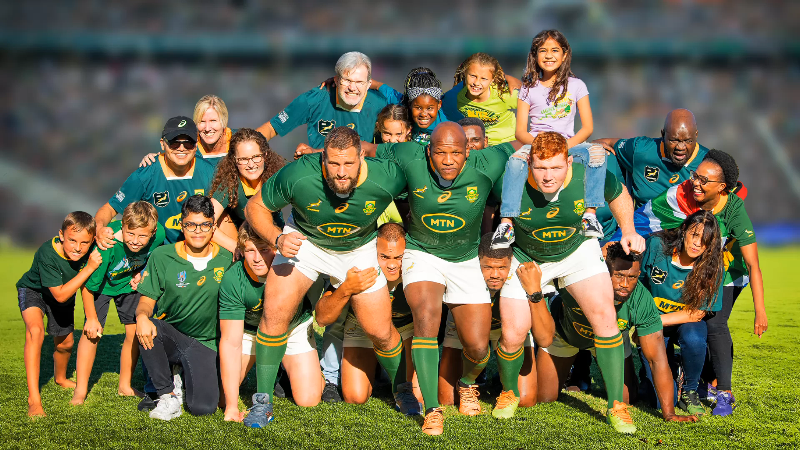
Y’ello TV Advert
Click to Play

Slide 35
07
The Numbers

Slide 36
The Results
July ‘22
BokSqaud
Launched
1,3m
Monthly Active Users
R25m
Gross Revenue Generated
R1,2m
Paid Media Budget
9
Digital Customer Acquisition Channels

Slide 37
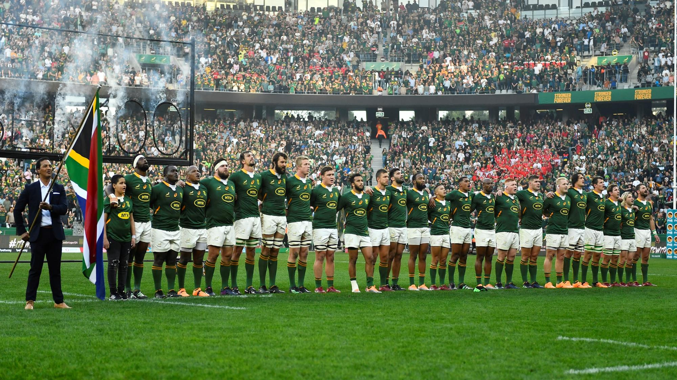
Thank You

